Slide 1


SAP UI5 & FIORI with OData TRAINING
Anubhav Oberoy & Shekhar Vedi
Day – 7

Slide 2

Agenda – Day 7
Dynamic Aggregation Binding
Element Binding
Concept of Base Controller
XML Model
Resource model in UI5
Multi-Language Support of the App
Formatter in UI5
User Experience and User Interface
Introduction to Fiori

Slide 3

Exercise - Dynamic Aggregation Binding
In this Exercise we will bind the rows property is the table dynamically form the column.
Exercise code/resources:
MyView.view.xml
MyView.controller.js

Slide 4
Element Binding
Element binding is useful for containers and layouts containing other controls. All these child controls would be required to use properties of the same model object or model node, then element-binding is preferable.
An element to be bound to an object in the Model can be achieved by Element binding.
Use case:- On Select of a row in the table show the row data in a form.
Table
/empTab/0
/empTab/1
/empTab/2
Emp Id | Emp Name | Salary
{empId} | {empName} | {salary}
Element 0
Element 1
Element 2
Simple Form
Field 0
/empId
All the content of Row 1 in the table is bind to all the fields in the form
Field 1
/empName
Field 2
/salary

Slide 5

Exercise
In this exercise we will use element binding to bind the data of a selected row with the form.
Exercise code/resources:-
MyView.view.xml
MyView.controller.js

Slide 6
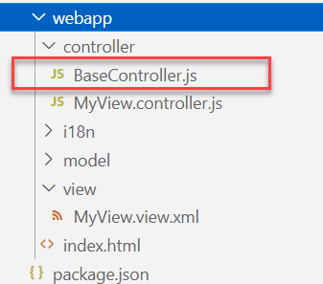
Concept of Base Controller in UI5
Base Controller:- A base controller is a controller with basic functionalities from which the other controllers in your SAPUI5 application inherit.
The base controller holds basic functionalities that are used across multiple controllers.
The base controller itself is just another JavaScript file and it does not have the .controller prefix. Just BaseController.js and not BaseController.controller.js.
The base controller goes in the controller folder in your SAPUI5 application folder structure:
sap/ui/core/mvc/Controller
x
BaseController
Template
x
Controller 1
x
Controller 2
x
Controller 3
x
Controller 4
View 1
View 2
View 3
View 4

Slide 7

Exercise
In this exercise we will create a new BaseController.
Along with that we will see how to load data to a model from a file.
Exercise code/resources: -
MyView.view.xml
MyView.controller.js
BaseController.js
mydata.json
mydata2.json
mydata.xml
model.js

Slide 8
XML Model
The XML model allows to bind controls to XML data. It is a client-side model intended for small datasets, which are completely available on the client. The XML model does not contain mechanisms for server-based paging or loading of deltas. It supports two-way binding.
To instantiate the model, use the following code:
var oModel = new sap.ui.model.xml.XMLModel();
The XML model allows to bind controls to XML data. It is a client-side model intended for small data sets, which are completely available on the client. The XML model does not contain mechanisms for server-based paging or loading of deltas. It supports two-way binding.
Setting/Loading Data in XML Model
In xml model data can be loaded by using the following syntax:
oModel.loadData("data.xml");
To set the data in XML model we can use the following syntax:
oModel.setData(oXMLDocument);
Ex:
oModel.setXML("<?xml version=\"1.0\"?><some><xml>data</xml></some>");
The data of model is of type XML always, since all the data values are treated as string data type the binding of other data types will create issues. These issues can be solved by adding more code hence to reduce these extra coding its recommended to use JSON model. E.g., smoker property of our employee example was treated as string which cause binding failure with check box’s selected property. Therefore, preferred model is always JSON model.

Slide 9

Exercise
In this exercise we will see how to create an XML model.
Then we see how to load data form xml file.
Exercise code/resource:-
MyView.view.xml
MyView.controller.js
models.js
mydata.xml

Slide 10
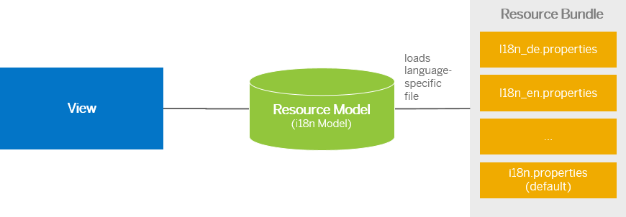
Resource Model
We build software for international audience, we cannot just hardcode every screen element in English, if it requires multi-lingual support, we need to add resource model.
i18n → Internationalization
Create resource bundle which includes label field
The name of the file must be i18n.properties for default labels
And i18n_langcode.properties for different languages
Set The model
For more information about i18n you check the link
https://openui5.hana.ondemand.com/1.34.9/docs/guide/831039835e7c4da3a8a0b49567573afe.html
We can change the language of the app by adding ?sap-language=language_code at the end of the URL of the app. Example for Hindi we will write ?sap-language=hi

Slide 11
Exercise
In this exercise we will see how the language of an app is changed using the i18n file.
We have to create a folder ‘i18n’ in webapps folder and in the folder, we have to add files named ‘i18n.properties’ and one another file named according to the language we want. For example:- for Hindi language the file is named as ‘i18n_hi.properties.
Along with that we will add a delete button on top of the table to delete the record of an employee from the model.
Exercise Code:-
MyView.view.xml
MyView.controller.js
i18n.properties
i18n_hi.properties

Slide 12
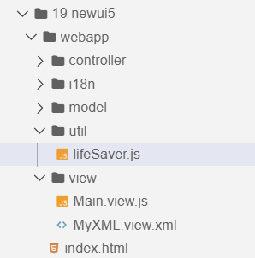
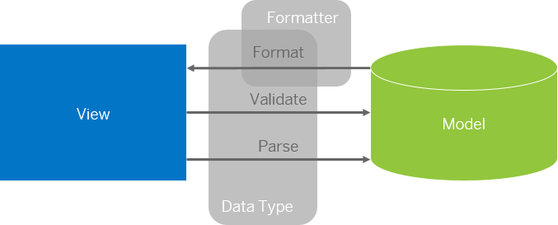
Formatter in SAP UI5
Formatters are used to define the formatting of data on the UI while data types work in both directions: they format the data on the UI and parse and validate user input that is entered.
Formatter is a function; This function gets called JUST Before the binding takes place with the view.
Formatter file is placed in a folder in webapp folder, and the file can be named anything with the .js extension.
Formatter

Slide 13

Exercise
In this exercise we are going to currency code in the table.
We will convert the currency code into its corresponding currency symbol.
We will achieve this by using a formatter function.
Exercise Code:-
MyView.view.xml
MyView.controller.js
lifeSaver.js

Slide 14
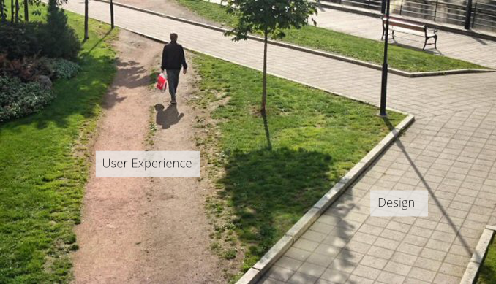
User Experience v/s User Interface
User interface is developer oriented. This is purely technical. We can change UI any number of times.
User experience is user oriented. It is psychological. We cannot change UX.

Slide 15
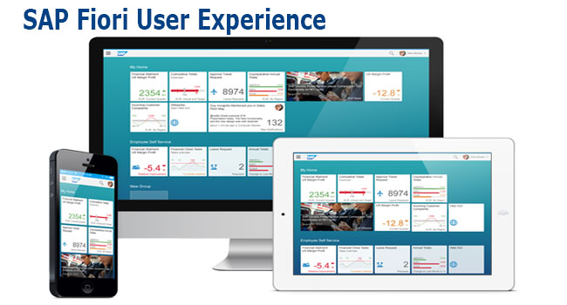
What is Fiori?
SAP Fiori is the user interface or user experience (UX) that supplements and can replace the SAP GUI. This streamlined application uses tiles to encapsulate standard tasks, such as approving purchase requisitions, viewing sales orders, and approving timesheets.
Fiori is SAP’s new user experience. These are standard apps delivered by SAP and by following the Development guidelines any one can use UI5 to create Fiori Apps.
Fiori is a streamlined application, delivering a role-based user experience that can be personalized across all lines of business, tasks and devices.
It uses tiles to encapsulate standard tasks like viewing sales orders or approving timesheets.
Fiori = UI5 + Development/Design Guidelines

Slide 16

End of Day 7

Slide 17

Questions

Slide 18

Anubhav Oberoy

Slide 19


We’re committed to empower you to be
Most Desirable Resource
through powerful training solutions.
We build the workforce of the future.
250+
Corporate Clients
30,000+
Learners Trained
25000+
Learners Placed
FREE WEBINARS
Sign up for free webinars with industry experts every fortnight!
Enroll Now!
Contact us today!
https://anubhavtrainings.com/

Slide 20




More from AnubhavTrainings.com

Slide 21
Title
Content

